Slide 1

Ministry: Government of Kerela
PS Code: SIH1324
Problem Statement Title: Air and water quality index and environment monitoring
Team Name: Windows 9/11
Team Leader Name: Atharva Sakpal
Institute Code (AISHE):
Institute Name: VJTI, Mumbai
Theme Name: Agriculture, Food Tech & Rural Development

Slide 2
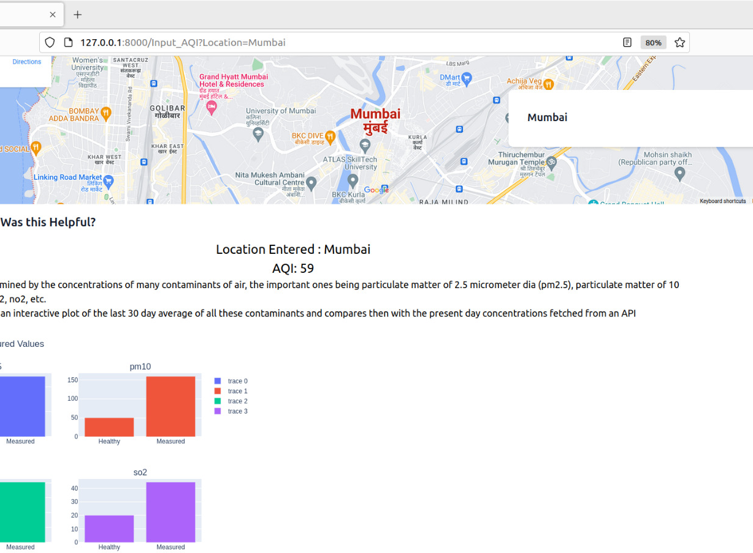
Approach Details
Approach
Assessing the air and water quality of a location entered by the user.
Comparing the quality of the air of the entered location with the ideal standards
Entering the concentrations of different compounds manually and classifying the water as portable or non portable
Displaying graphs for better analysis and making future predictions using an ML model
Technology stack:
Tailwind CSS
JavaScript
Django
Python
Machine learning (logistic regression and xgboost time series for prediction)

Slide 3
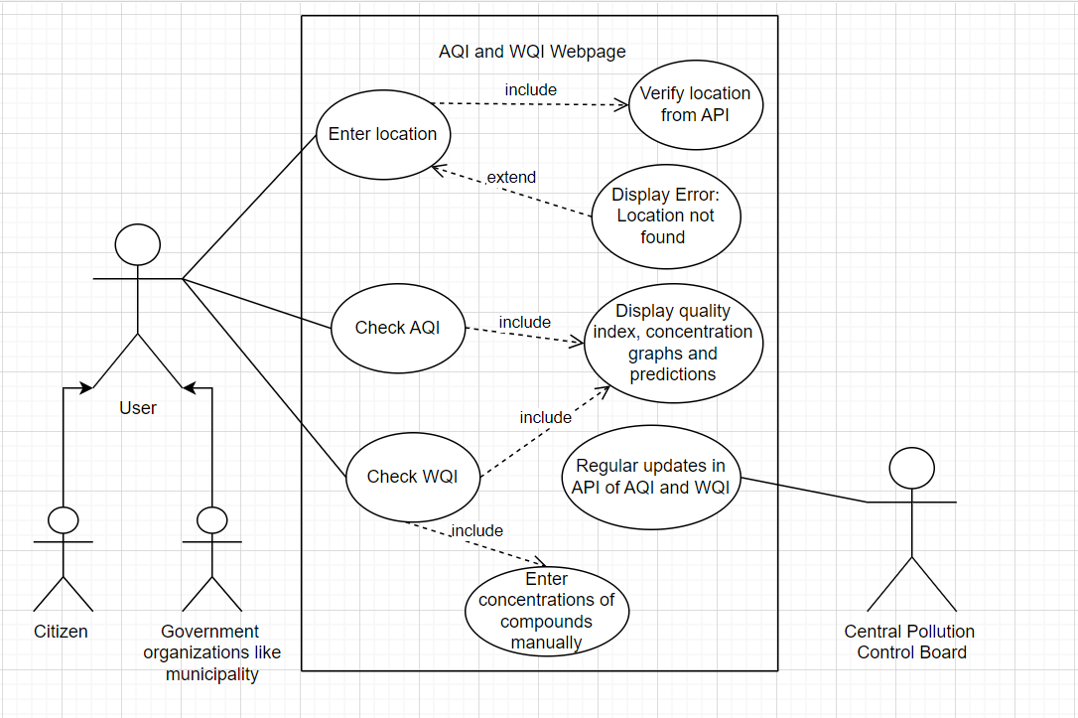
Approach Details
Use Case Diagram:
Dependencies:
Currently we are importing details for AQI from the OpenWeather API which gives us real time data, but we need to improve its prediction accuracy.
We are entering the concentrations of different components for checking the water quality.
The government can provide us with the concentrations of water sample from different locations by directly connecting us with the sever where the data is stored.

Slide 4
Team Member Details
Team Leader Name: Atharva Sakpal
Btech Electronics Second year (II)
Team Member 1 Name: Anish Mahadevan
Btech Electronics Second year (II)
Team Member 2 Name: Ishayu Potey
Btech Electronics Second year (II)
Team Member 3 Name: Keyur Apte
Btech Electronics Second year (II)
Team Member 4 Name: Shashwat Barai
Btech Electronics Second year (II)
Team Member 5 Name: Shreya Chaudhari
Btech Electronics Second year (II)

